Slide 1
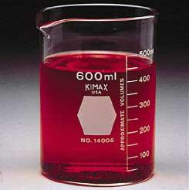
Laboratory Equipment
Unit 1 - Laboratory
Integrated Science

Slide 2
Lesson Essential Question
What type of equipment will I be using in lab?

Slide 3
Beaker
Pour, Mix, Heat, Cool liquids in beakers.
Never measure volumes in a beaker.

Slide 4
Erlenmeyer Flask
Pour, Heat, Cool liquids. Used to heat liquids and solids that will most likely release gases and splatter.

Slide 5
How do I cover a beaker?
Watch Glass
Glass Plate

Slide 6
Graduated Cylinders
Used to measure liquids accurately.

Slide 7
Test Tubes and Test Tube Rack Used for mixing and heating chemicals – smaller quantities than beakers and flasks

Slide 8
Test Tube Brushes Used to clean test tubes.

Slide 9
24 Well Microplate
96 Well Microplate
These are used in place of test tubes when smaller volumes are being reacted.

Slide 10
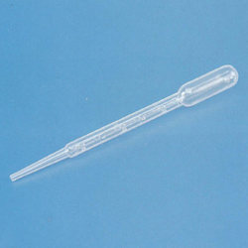
For dropping different amounts of liquid use….
Medicine Dropper
Microtip or thin stem pipette

Slide 11
Bunsen Burner and Hose Connector
Used to heat in a chemistry laboratory.

Slide 12
You can also “cook” using a Hot Plate.

Slide 13
Test Tube Holder
Use this apparatus when heating a test tube.
Remember- Do not aim a test tube at anyone.

Slide 14
Ring Stand
This is used to attach clamps and other apparatus that you will view next.

Slide 15
Utility Clamp Used to hold objects on a ring stand.

Slide 16
Heating Setup
This is what it looks like when you heat the contents of a beaker.

Slide 17
You could also attach a…
Thermometer Holder
Thermometer

Slide 18
This could also be attached to a ring stand. Reminder – never let the thermometer touch the bottom of a piece of glassware being heated.

Slide 19
To heat substances at a very high temperature use a Crucible and Lid.

Slide 20
To hold a hot crucible use…
Crucible Tongs

Slide 21
How do I use crucible tongs?
To hold lid….
To hold Crucible…

Slide 22
To heat a crucible you will also need a Clay Triangle.

Slide 23
Crucible with Lid Setup
Crucibles are used to heat substances to very high temperatures.
Notice the following equipment:
Ring Stand, Iron Ring, Clay Triangle, Bunsen Burner, Crucible and Lid and Crucible Tongs.

Slide 24
Evaporating Dish
Used to evaporate liquids from solids under high temperatures.

Slide 25
How do I hold glass when it is hot?
Beaker Tongs
Test Tube Holder

Slide 26
Powder Funnel
Filter Funnel
Powder Funnel – used for dry solids.
Filter Funnel – used to filter solids from liquids
with filter paper.

Slide 27
Filter Funnel Setup

Slide 28
How do we stir chemicals?
Stirring Rod
Rubber Policeman
Works like a cake spatula. Allows you to scrape solids out of containers.

Slide 29
Where does the name “Rubber Policeman” come from?
The name "rubber policeman" comes from the 19th-century German chemist Carl Remigius Fresenius, who explained that chemists could remove solids from the walls of glass beakers with an instrument he called a "policeman. The police are always thorough so that’s where he got the idea.

Slide 30
Two Ways to Mass Solids
Triple Beam Balance
Electronic Balance

Slide 31
To Mass Solids you will also need….
Weigh Boats
Spatula/Scoopula

Slide 32
Triangular File For scoring glass or metal.

Slide 33
Here is a helpful website with flashcards and quizzes to aid you in learning the lab equipment. https://quizlet.com/119920316/chemistry-equipment-flash-cards/

